Slide 1
Bedfordshire Rural Communities Charity

Slide 2
Beds RCC

Slide 3
Overview of Beds RCC
Supporting and Engaging Communities
Health and Wellbeing
Green Infrastructure and Sustainability
Community
Transport
Digital Connection
Supporting Culture and Heritage
Community
Business
Our People and Partners
Notes:
Video introduced by TC

Slide 4
Social Prescribing’…….what is it?
Social prescribing, sometimes referred to as community referral, is where GPs, Nurses, Allied Health Professionals, Social Workers & VCSE refer people via a social prescribing link worker, to a variety of non-clinical services in their local area which can help to improve their health or other issues they are dealing with. Health & Wellbeing Coaches can support people to reach GOALS and improve their Health & Wellbeing.

Slide 5
How does it work?
Social Prescribing aims to help people take control of their own health and wellbeing by focussing on what matters to them – what they want to achieve and how they can be supported to achieve this
We aim to support people to connect with local community services and activities which meet their own needs, goals and interests
One of our biggest assets is time. We offer initial appointments of up to an hour so we can really listen to and understand the needs and aspiration of our clients
Notes:
Video introduced by TC

Slide 6
How does it work?
Our service offers an average of 4 to 8 contacts with a client over a 3 to 6-month period although we are person centred so this will vary depending on need
All our work is underpinned by our health coaching skills, enabling us to work with clients to develop the knowledge, skills and confidence to become more active in their own care and maximise personal wellbeing and overall health
Notes:
Video introduced by TC

Slide 7
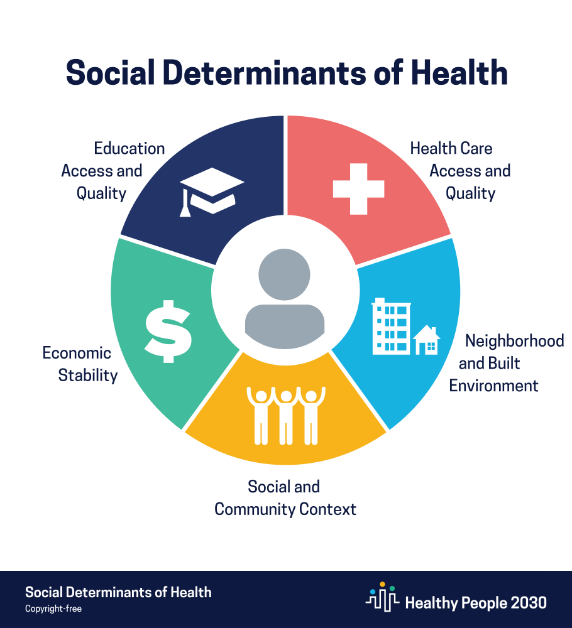
National Framework
Notes:
Video introduced by TC

Slide 8
CRSP; referral criteria
Aged 18+ who would benefit from ‘health coaching’ and non-clinical support. This may include;
Carers
Those who are socially isolated
History of mild to moderate mental health conditions that interfere with daily functions
Those with long-term conditions who are not responding well to medical interventions
Those who have the capacity to self-manage with community-based support
Frequent attenders at GP surgeries for non-medical reasons
Exclusion; Adults actively receiving support from Community Mental Health Teams.
(they are referred via a different pathway)
We have referral pathways with Primary Care, Statutory Services and Community Organisations.
Social Prescribing Referral Form is embedded on SystemOne or you can refer via our online form
We have a secure Single Point Of Access NHS email address

Slide 9
What happens when you refer?
A Community Wellbeing Champion will complete a holistic assessment to identify other areas of support, and connect them. These offer may for support with;
Housing, Debt, Isolation, Health Literacy, Fuel Poverty, Food bank, Education & Employment and more.
If it is a service we deliver we offer a swift internal referral process
We are person centred; our interventions are agreed with the referred.

Slide 10
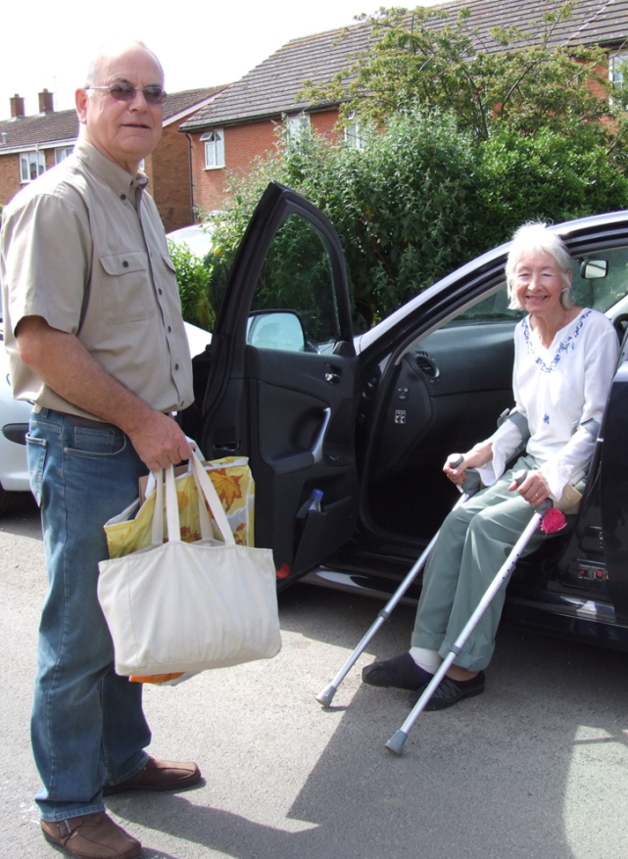
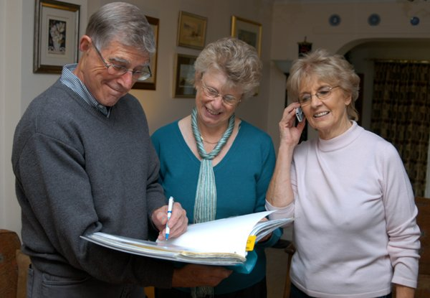
Good Neighbour Scheme
How schemes help
Good Neighbour schemes can help to lessen the impact on a community caused by the decline in services and facilities such as public transport, shops, Post Offices, doctor’s surgeries and pubs.
They can also help to reduce feelings of isolation and exclusion experienced by some individuals if families and friends move away in the search for employment, education or affordable housing.
Each scheme is an independent community group run by local people for local people
Typical help - lifts; shopping; befriending; pet care; light DIY; help with admin or IT; signposting to other services.

Slide 11
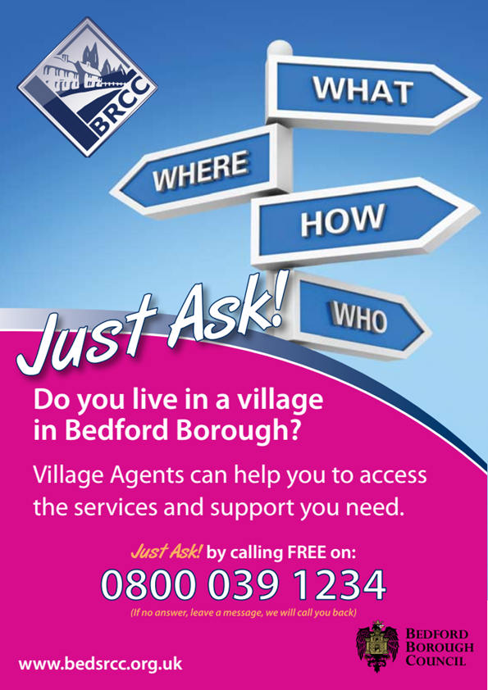
Community Agents
Help isolated and vulnerable people access info and support;
- one to one help and/or link to other services
- catch people before they need social care
- equip people to use their own assets and natural supports; income; family and friends; local community
- boost community support; good neighbour groups and local volunteers
- increase independence; choice; better quality of life

Slide 12
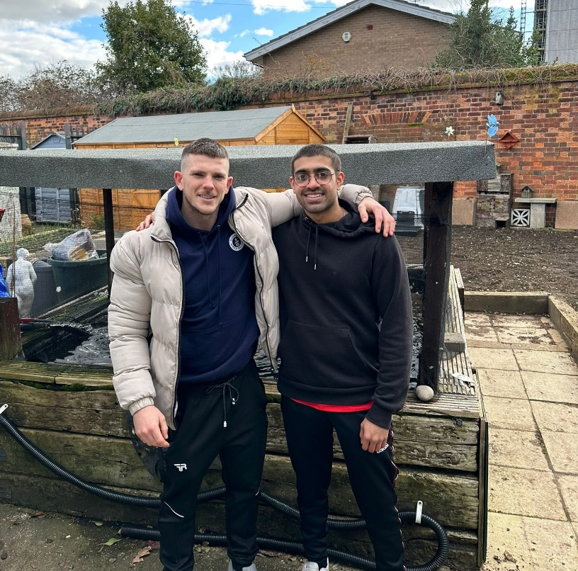
Green Social Prescribing

Slide 13
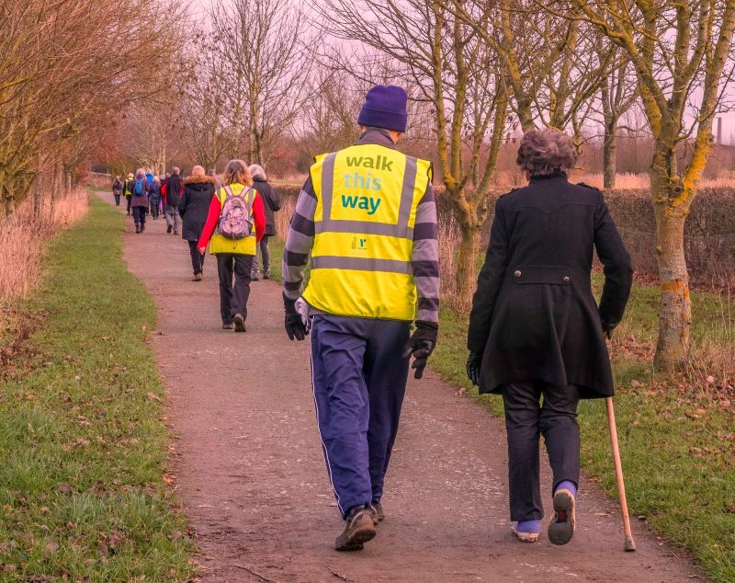
Wellbeing Walks
Over 11,500 person walks in 2023
Up to 93 walks a month
Across 32 locations in Central Bedfordshire and Bedford Borough.
The walks are free, aimed at people who are less active.

Slide 14
One Slide
How “You Can Do IT!” Works
We work one-to-one, with a person-centred objectives list focused on Health & Wellbeing, in a community group location meeting weekly.
We focus on the very basics. We don’t aim to provide work-based IT skills training. Our aim is to enable learners to use online services with confidence so that they can safely access websites, use email and communicate by voice and video calls.
We equip people with the skills and technology that they need to get online independently. We can supply loan devices and connectivity (for a six month period).

Slide 15
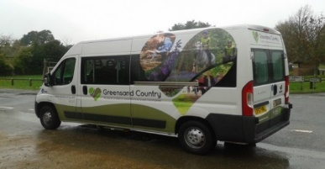
Community Transport
We provide wheelchair accessible minibuses with drivers and passenger assistants for those unable to use public transport. Providing a safe, accessible service for those who are unable to use ordinary public transport due to their physical or mental health. Our team will follow a personalised care plan to meet the needs of all customers.
We provide door-to-door dial-a-ride services across the Ivel area and mid-beds.
We travel over 80,000 miles a year, regularly transporting passengers to rehabilitation centres, day care centres, medical appointments, shopping and other places that benefit people’s wellbeing.
We also undertake contract work which helps subside our dial-a-ride services. Do email us: communitytransport@bedsrcc.org.uk if you have any transport requirements that could be met by our seven wheelchair accessible minibuses, PA’s and drivers.

